Slide 1
Chapter 13
Graph Algorithms
1843
ORD
SFO
802
337
1743
LAX
1233
DFW
Acknowledgement: These slides are adapted from slides provided with Data Structures and Algorithms in C++, Goodrich, Tamassia and Mount (Wiley 2004) and slides from Nancy M. Amato
Notes:
1
1

Slide 2
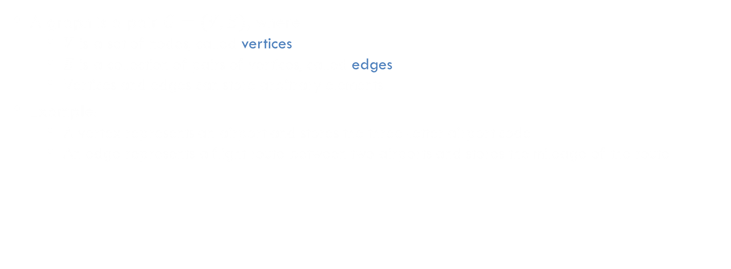
Graph
A graph is a pair $G=(V, E)$, where
  $V$ is a set of nodes, called vertices
  $E$ is a collection of pairs of vertices, called edges
  Vertices and edges can store arbitrary elements
Example:
  A vertex represents an airport and stores the three-letter airport code
  An edge represents a flight route between two airports and stores the mileage of the route
849
PVD
1843
ORD
142
SFO
802
LGA
337
1743
1387
HNL
2555
1099
LAX
1233
DFW
1120
MIA
Notes:
Represent connectivity information between objects

Slide 3




Edge & Graph Types
Edge Types
  Directed edge
    ordered pair of vertices $(u, v)$
    first vertex $u$ is the origin/source
    second vertex $v$ is the destination/target
    e.g., a flight
  Undirected edge
    unordered pair of vertices $(u, v)$
    e.g., a flight route
  Weighted edge
Graph Types
  Directed graph (Digraph)
    all the edges are directed
    e.g., route network
  Undirected graph
    all the edges are undirected
    e.g., flight network
  Weighted graph
    all the edges are weighted
$$(u, v)$$
$$u$$
$$v$$
flight
AA 1206
ORD
DFW
802 miles
flight
route
ORD
DFW
802 miles

Slide 4
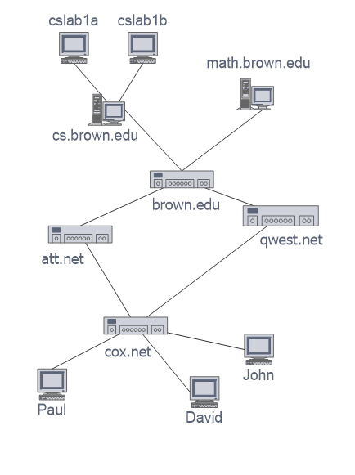
Applications
Electronic circuits
  Printed circuit board
  Integrated circuit
Transportation networks
  Highway network
  Flight network
Computer networks
  Local area network
  Internet
  Web
Databases
  Entity-relationship diagram

Slide 5

Terminology
End points (or end vertices) of an edge
  $U$ and $V$ are the endpoints of $a$
Edges incident on a vertex
  $a$, $d$, and $b$ are incident on $V$
Adjacent vertices
  $U$ and $V$ are adjacent
Degree of a vertex
  $X$ has degree 5
Parallel (multiple) edges
  $h$ and$i$ are parallel edges
Self-loop
  $j$ is a self-loop
V
a
b
h
j
U
d
X
Z
c
e
i
W
g
f
Y

Slide 6

Terminology
Outgoing edges of a vertex
  $h$ and $b$ are the outgoing edges of $X$
Incoming edges of a vertex
  e, g, and $i$ are incoming edges of $X$
In-degree of a vertex
  $X$ has in-degree 3
Out-degree of a vertex
  $X$ has out-degree 2
V
b
h
j
d
X
Z
e
i
W
g
f
Y

Slide 7

Terminology
Path
  Sequence of alternating vertices and edges
  Begins with a vertex
  Ends with a vertex
  Each edge is preceded and followed by its endpoints
Simple path
  Path such that all its vertices and edges are distinct
Examples
  $P_{1}=\left\{V,b,X,h,Z\right\}$is a simple path
  $P_{2}=\left\{U,c,W,e,X,g,Y,f,W,d,V\right\}$ is a path that is not simple
V
a
b
P₁
d
U
X
Z
P₂
h
c
e
W
g
f
Y

Slide 8

Terminology
Cycle
  Circular sequence of alternating vertices and edges
  Each edge is preceded and followed by its endpoints
Simple cycle
  Cycle such that all its vertices and edges are distinct
Examples
  $C_{1}=\left\{V,b,X,g,Y,f,W,c,U,a,V\right\}$is a simple cycle
  $C_{2}=\left\{U,c,W,e,X,g,Y,f,W,d,V,a,U\right\}$is a cycle that is not simple
V
a
b
d
U
X
Z
C₂
h
e
C₁
c
W
g
f
Y

Slide 9
Exercise on Terminology
Number of vertices?
Number of edges?
What type of the graph is it?
Show the end vertices of the edge with largest weight
Show the vertices of smallest degree and largest degree
Show the edges incident to the vertices in the above question
Identify the shortest simple path from HNL to PVD
Identify the simple cycle with the most edges
849
PVD
1843
ORD
142
SFO
802
LGA
337
1743
1387
HNL
2555
1099
LAX
1233
DFW
1120
MIA
Notes:
Represent connectivity information between objects

Slide 10



Exercise
Properties of Undirected Graphs
Property 1 – Total degree
  $$Σ_{v}deg\left(v\right)=?$$
Property 2 – Total number of edges
  In an undirected graph with no self-loops and no multiple edges
  $$m≤Upper Bound? \\ Lower Bound?≤m$$
Notation
  $n$ number of vertices
  $m$ number of edges
  $deg(v)$ degree of vertex v
Example
  $n=?$
  $m=?$
  $\deg\left(v\right)=?$
A graph with given number of vertices (4) and maximum number of edges

Slide 11



Exercise
Properties of Undirected Graphs
Property 1 – Total degree
  $$Σ_{v}deg\left(v\right)=2m$$
Property 2 – Total number of edges
  In an undirected graph with no self-loops and no multiple edges
  $$m≤\frac{n(n−1)}{2} \\ 0≤m$$
  Proof: Each vertex can have degree at most $\left(n−1\right)$
Notation
  $n$ number of vertices
  $m$ number of edges
  $deg(v)$ degree of vertex v
Example
  $n=4$
  $m=6$
  $\deg\left(v\right)=3$
A graph with given number of vertices (4) and maximum number of edges

Slide 12

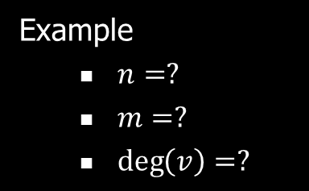

Exercise
Properties of Directed Graphs
Property 1 – Total in-degree and out-degree
$Σ_{v}in−deg⁡(v)=?$
$Σ_{v}out−\deg\left(v\right)=?$
Property 2 – Total number of edges
  In an directed graph with no self-loops and no multiple edges
  $m≤UpperBound?$
  $LowerBound?≤m$
Notation
  $n$ number of vertices
  $m$ number of edges
  $deg⁡(v)$ degree of vertex v
Example
  $n=?$
  $m=?$
  $\deg\left(v\right)=?$
A graph with given number of vertices (4) and maximum number of edges

Slide 13

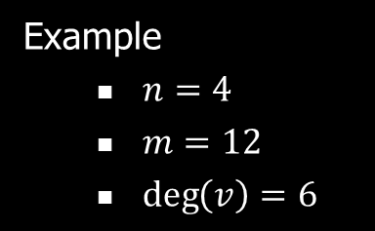
Exercise
Properties of Directed Graphs
Property 1 – Total in-degree and out-degree
$Σ_{v}in−deg⁡(v)=m$
$Σ_{v}out−\deg\left(v\right)=m$
Property 2 – Total number of edges
  In an directed graph with no self-loops and no multiple edges
  $m≤n\left(n−1\right)$
  $0≤m$
Notation
  $n$ number of vertices
  $m$ number of edges
  $deg⁡(v)$ degree of vertex v
Example
  $n=4$
  $m=12$
  $\deg\left(v\right)=6$
A graph with given number of vertices (4) and maximum number of edges

Slide 14

Subgraphs
A subgraph $S$ of a graph $G$ is a graph such that
  The vertices of $S$ are a subset of the vertices of $G$
  The edges of $S$ are a subset of the edges of $G$
A spanning subgraph of $G$ is a subgraph that contains all the vertices of $G$
Subgraph
Spanning subgraph

Slide 15

Connectivity
A graph is connected if there is a path between every pair of vertices
A connected component of a graph $G$ is a maximal connected subgraph of $G$
Connected graph
Non connected graph with two connected components

Slide 16

Trees and Forests
A (free) tree is an undirected graph $T$such that
  $T$ is connected
  $T$ has no cycles
  This definition of tree is different from the one of a rooted tree
A forest is an undirected graph without cycles
The connected components of a forest are trees
Tree
Forest

Slide 17
Spanning Trees and Forests
A spanning tree of a connected graph is a spanning subgraph that is a tree
A spanning tree is not unique unless the graph is a tree
Spanning trees have applications to the design of communication networks
A spanning forest of a graph is a spanning subgraph that is a forest
Graph
Spanning tree

Slide 18


Graph ADT
Vertices and edges are positions and store elements
Vertex ADT
  $operator∗\left(\right)$
  $incidentEdges\left(\right)$
  $isAdjacentTo(v)$
Edge ADT
  $operator∗\left(\right)$
  $endVertices\left(\right)$
  $opposite(v)$
  $isAdjacentTo(f)$
  $isIncidentOn(v)$
  $isDirected\left(\right)$
  $origin\left(\right)$
  $dest\left(\right)$
Graph ADT
  $vertices\left(\right)$
  $edges\left(\right)$
  $insertVertex\left(x\right)$
  $insertEdge(v, w, x)$
  $insertDirectedEdge(v, w, x)$
  $eraseVertex\left(v\right)$
  $eraseEdge(e)$
Many more generic/accessor methods
Lists of entities provide iterators

Slide 19


Exercise on ADT
$insertVertex(iah)$
$insertEdge(mia, pvd, 1200)$
$eraseVertex(ord)$
$eraseEdge(dfw, ord)$
$\left(dfw, lga\right).isDirected()$
$\left(dfw, lga\right).origin()$
$\left(dfw, lga\right).dest()$
$ord.incidentEdges()$
$ord.adjacentVertices()$
$ord.degree()$
$\left(lga, mia\right).endVertices()$
$\left(dfw, lga\right).opposite(dfw)$
$dfw.isAdjacentTo(sfo)$
849
PVD
1843
ORD
142
SFO
802
LGA
337
1743
1387
HNL
2555
1099
LAX
1233
DFW
1120
MIA
Notes:
Represent connectivity information between objects

Slide 20
Edge List Structure
Edge List
Vertex Sequence
An edge list can be stored in a sequence, a vector, a list or a dictionary such as a hash table
(ORD, PVD)
849
ORD
(ORD, DFW)
802
LGA
(LGA, PVD)
142
PVD
849
PVD
ORD
142
(LGA, MIA)
1099
DFW
802
LGA
(DFW, LGA)
1387
MIA
1387
1099
DFW
1120
(DFW, MIA)
1120
MIA

Slide 21
Exercise
Edge List Structure
Construct the edge list for the following graph
x
u
a
y
z
v

Slide 22
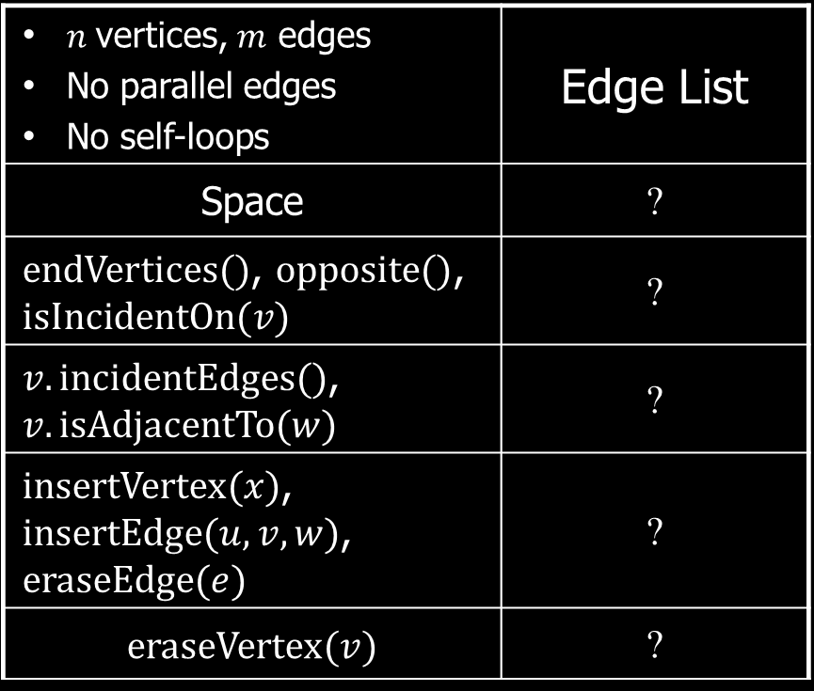
Asymptotic Performance
Edge List Structure
$n$vertices, $m$ edges No parallel edges No self-loops | Edge List
Space | ?
$endVertices()$, $opposite()$, $isIncidentOn(v)$ | ?
$v.incidentEdges()$, $v.isAdjacentTo(w)$ | ?
$insertVertex(x)$, $insertEdge(u, v, w)$, $eraseEdge(e)$ | ?
$$eraseVertex(v)$$ | ?
Edge List
Vertex Sequence
Weight
Directed
Degree
(ORD, PVD)
849
False
ORD
2
(ORD, DFW)
802
False
LGA
3
(LGA, PVD)
142
False
PVD
2
(LGA, MIA)
1099
False
DFW
3
(DFW, LGA)
1387
False
MIA
2
(DFW, MIA)
1120
False

Slide 23
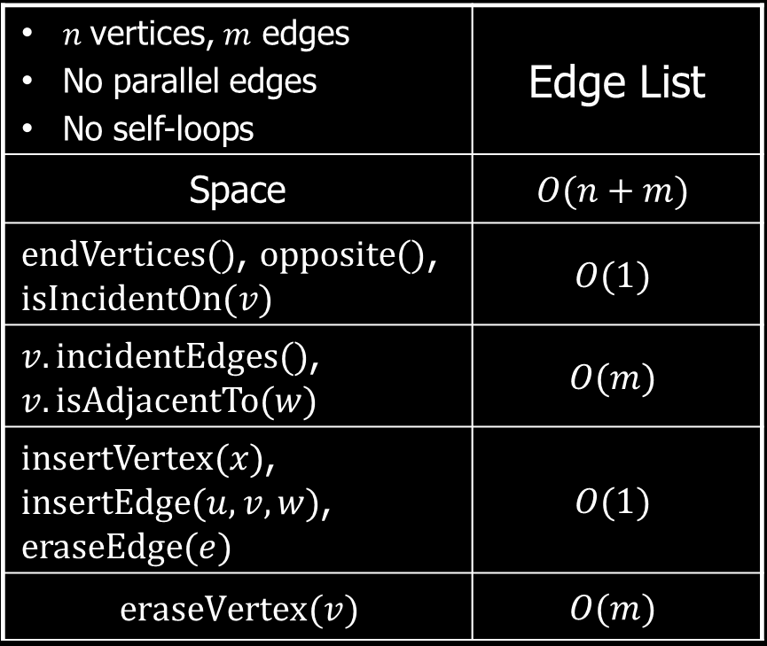
Asymptotic Performance
Edge List Structure
$n$vertices, $m$ edges No parallel edges No self-loops | Edge List
Space | $$O(n+m)$$
$endVertices()$, $opposite()$, $isIncidentOn(v)$ | $$O(1)$$
$v.incidentEdges()$, $v.isAdjacentTo(w)$ | $$O(m)$$
$insertVertex(x)$, $insertEdge(u, v, w)$, $eraseEdge(e)$ | $$O(1)$$
$$eraseVertex(v)$$ | $$O(m)$$
Edge List
Vertex Sequence
Weight
Directed
Degree
(ORD, PVD)
849
False
ORD
2
(ORD, DFW)
802
False
LGA
3
(LGA, PVD)
142
False
PVD
2
(LGA, MIA)
1099
False
DFW
3
(DFW, LGA)
1387
False
MIA
2
(DFW, MIA)
1120
False

Slide 24
Edge List Structure
u
a
c
Vertex object
  element
  reference to position in vertex sequence
Edge object
  element
  origin vertex object
  destination vertex object
  reference to position in edge sequence
Vertex sequence
  sequence of vertex objects
Edge sequence
  sequence of edge objects
b
d
v
w
z
u
v
w
z
a
b
c
d

Slide 25
Adjacency List Structure
849
PVD
ORD
142
802
LGA
1387
1099
DFW
1120
MIA
Adjacency List
ORD
(ORD, PVD)
(ORD, DFW)
Adjacency Lists associate edges with their end vertices
Each vertex stores a list of incident edges
LGA
(LGA, PVD)
(LGA, MIA)
(LGA, DFW)
PVD
(PVD, ORD)
(PVD, LGA)
DFW
(DFW, ORD)
(DFW, LGA)
(DFW, MIA)
MIA
(MIA, LGA)
(MIA, DFW)

Slide 26
Exercise
Adjacency List Structure
Construct the adjacency list for the following graph
x
u
a
y
z
v

Slide 27
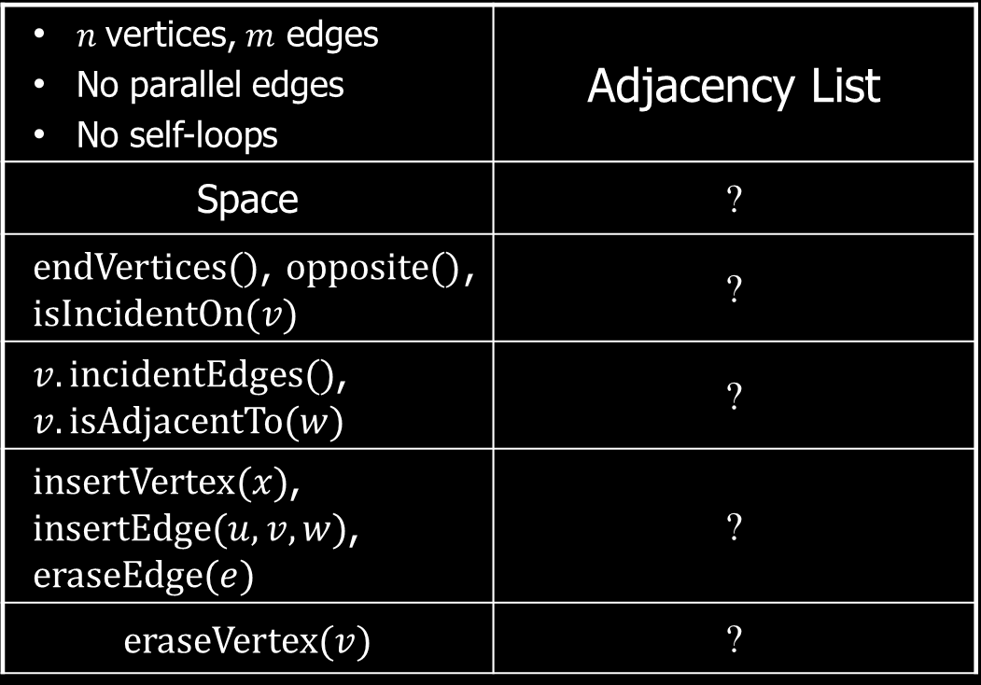
Asymptotic Performance
Adjacency List Structure
$n$vertices, $m$ edges No parallel edges No self-loops | Adjacency List
Space | ?
$endVertices()$, $opposite()$, $isIncidentOn(v)$ | ?
$v.incidentEdges()$, $v.isAdjacentTo(w)$ | ?
$insertVertex(x)$, $insertEdge(u, v, w)$, $eraseEdge(e)$ | ?
$$eraseVertex(v)$$ | ?
Adjacency List
ORD
(ORD, PVD)
(ORD, DFW)
LGA
(LGA, PVD)
(LGA, MIA)
(LGA, DFW)
PVD
(PVD, ORD)
(PVD, LGA)
DFW
(DFW, ORD)
(DFW, LGA)
(DFW, MIA)
MIA
(MIA, LGA)
(MIA, DFW)

Slide 28
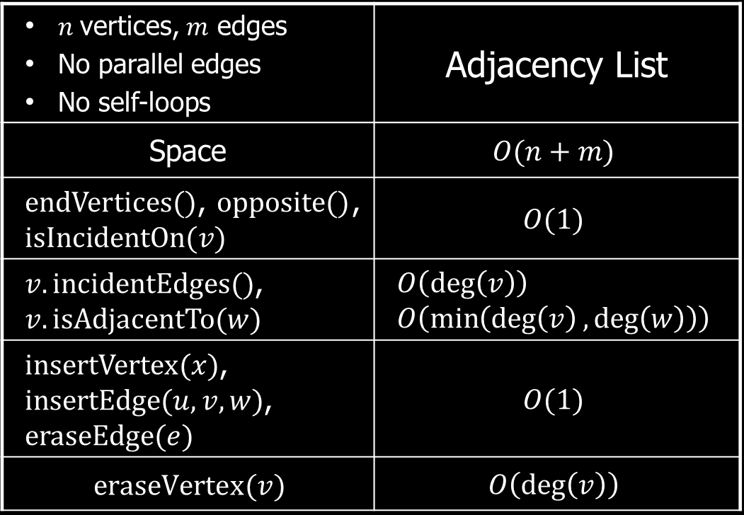
Asymptotic Performance
Adjacency List Structure
$n$vertices, $m$ edges No parallel edges No self-loops | Adjacency List
Space | $$O(n+m)$$
$endVertices()$, $opposite()$, $isIncidentOn(v)$ | $$O(1)$$
$v.incidentEdges()$, $v.isAdjacentTo(w)$ | $$O\left(\deg\left(v\right)\right) \\ O\left(\min\left(\deg\left(v\right),\deg\left(w\right)\right)\right)$$
$insertVertex(x)$, $insertEdge(u, v, w)$, $eraseEdge(e)$ | $$O(1)$$
$$eraseVertex(v)$$ | $$O\left(\deg\left(v\right)\right)$$
Adjacency List
ORD
(ORD, PVD)
(ORD, DFW)
LGA
(LGA, PVD)
(LGA, MIA)
(LGA, DFW)
PVD
(PVD, ORD)
(PVD, LGA)
DFW
(DFW, ORD)
(DFW, LGA)
(DFW, MIA)
MIA
(MIA, LGA)
(MIA, DFW)

Slide 29
Adjacency List Structure
a
v
b
u
w
Store vertex sequence and edge sequence
Each vertex stores a sequence of incident edges
  Sequence of references to edge objects of incident edges
Augmented edge objects
  References to associated positions in incidence sequences of end vertices
u
v
w
a
b

Slide 30
Adjacency Matrix Structure
 | 0 | 1 | 2 | 3 | 4
0 | 0 | 0 | 1 | 1 | 0
1 | 0 | 0 | 1 | 1 | 1
2 | 1 | 1 | 0 | 0 | 0
3 | 1 | 1 | 0 | 0 | 1
4 | 0 | 1 | 0 | 1 | 0
Adjacency matrices store edges in a table, indexed by the vertex
0
2
1
3
4

Slide 31
Exercise
Adjacency Matrix Structure
Construct the adjacency matrix for the following graph
x
u
a
y
z
v

Slide 32
Adjacency Matrix Structure In a
Weighted Graph
 | 0 ORD | 1 LGA | 2 PVD | 3 DFW | 4 MIA
0 ORD | 0 | 0 | 849 | 802 | 0
1 LGA | 0 | 0 | 142 | 1387 | 1099
2 PVD | 849 | 142 | 0 | 0 | 0
3 DFW | 802 | 138 | 0 | 0 | 1120
4 MIA | 0 | 1099 | 0 | 1120 | 0
Store edge object/property in table, or include a pointer to it inside of the table
849
2:PVD
0:ORD
142
1:LGA
802
1387
1099
3:DFW
1120
4:MIA

Slide 33
Exercise
Adjacency Matrix Structure: Weighted Digraph
 | 0 ORD | 1 LGA | 2 PVD | 3 DFW | 4 MIA
0 ORD
1 LGA
2 PVD
3 DFW
4 MIA
849
2:PVD
0:ORD
142
1:LGA
802
1387
1099
3:DFW
1120
4:MIA

Slide 34
Exercise
Adjacency Matrix Structure: Weighted Digraph
 | 0 ORD | 1 LGA | 2 PVD | 3 DFW | 4 MIA
0 ORD | 0 | 0 | 849 | 0 | 0
1 LGA | 0 | 0 | 0 | 1387 | 1099
2 PVD | 0 | 142 | 0 | 0 | 0
3 DFW | 802 | 0 | 0 | 0 | 0
4 MIA | 0 | 0 | 0 | 1120 | 0
849
2:PVD
0:ORD
142
1:LGA
802
1387
1099
3:DFW
1120
4:MIA

Slide 35
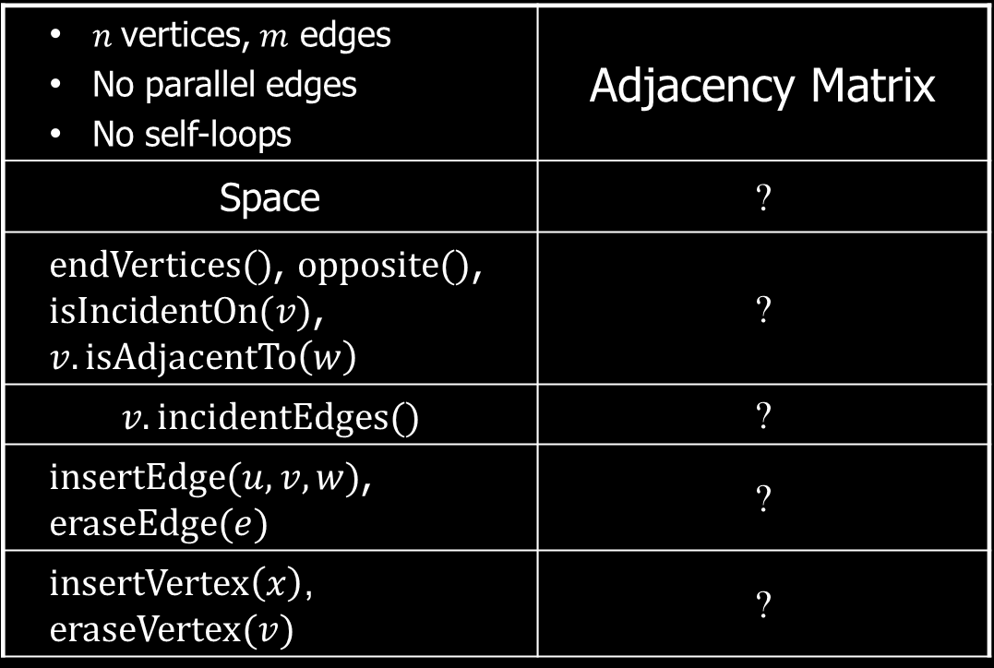
Asymptotic Performance of Adjacency Matrix Structure
$n$vertices, $m$ edges No parallel edges No self-loops | Adjacency Matrix
Space | ?
$endVertices()$, $opposite()$, $isIncidentOn(v)$, $v.isAdjacentTo\left(w\right)$ | ?
$$v.incidentEdges()$$ | ?
$insertEdge(u, v, w)$, $eraseEdge(e)$ | ?
$insertVertex\left(x\right)$, $eraseVertex(v)$ | ?
 | 0 | 1 | 2 | 3 | 4
0 | 0 | 0 | 1 | 1 | 0
1 | 0 | 0 | 1 | 1 | 1
2 | 1 | 1 | 0 | 0 | 0
3 | 1 | 1 | 0 | 0 | 1
4 | 0 | 1 | 0 | 1 | 0

Slide 36
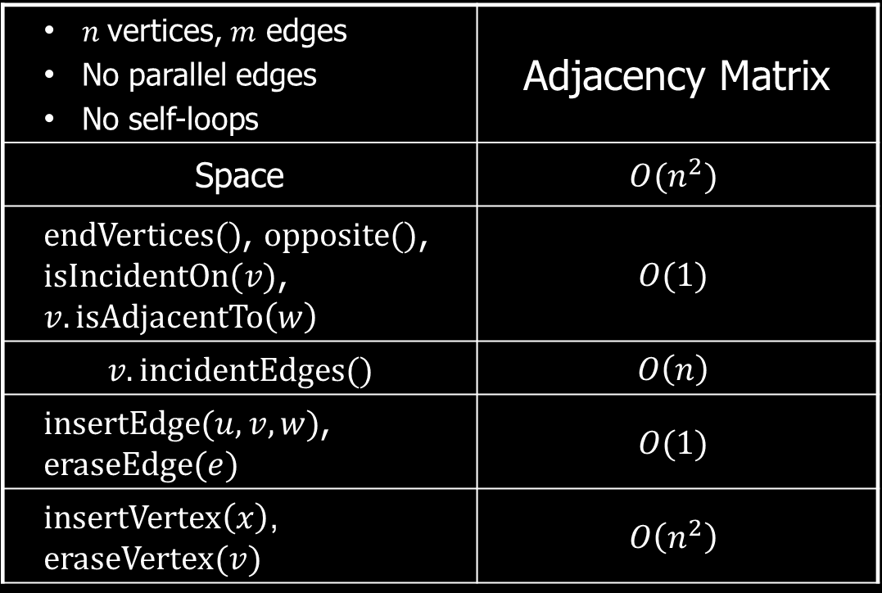
Asymptotic Performance of Adjacency Matrix Structure
$n$vertices, $m$ edges No parallel edges No self-loops | Adjacency Matrix
Space | $$O(n^{2})$$
$endVertices()$, $opposite()$, $isIncidentOn(v)$, $v.isAdjacentTo\left(w\right)$ | $$O(1)$$
$$v.incidentEdges()$$ | $$O\left(n\right)$$
$insertEdge(u, v, w)$, $eraseEdge(e)$ | $$O(1)$$
$insertVertex\left(x\right)$, $eraseVertex(v)$ | $$O\left(n^{2}\right)$$
 | 0 | 1 | 2 | 3 | 4
0 | 0 | 0 | 1 | 1 | 0
1 | 0 | 0 | 1 | 1 | 1
2 | 1 | 1 | 0 | 0 | 0
3 | 1 | 1 | 0 | 0 | 1
4 | 0 | 1 | 0 | 1 | 0

Slide 37
Adjacency Matrix Structure
a
v
b
u
w
Augmented vertex objects
  Integer key (index) associated with vertex
2D-array adjacency array
  Reference to edge object for adjacent vertices
  Null for non nonadjacent vertices
The “old fashioned” version just has 0 for no edge and 1 for edge
0
u
1
v
2
w
 | 0 | 1 | 2
0 | ∅ |  | ∅
1 |  | ∅
2 | ∅ |  | ∅
a
b

Slide 38
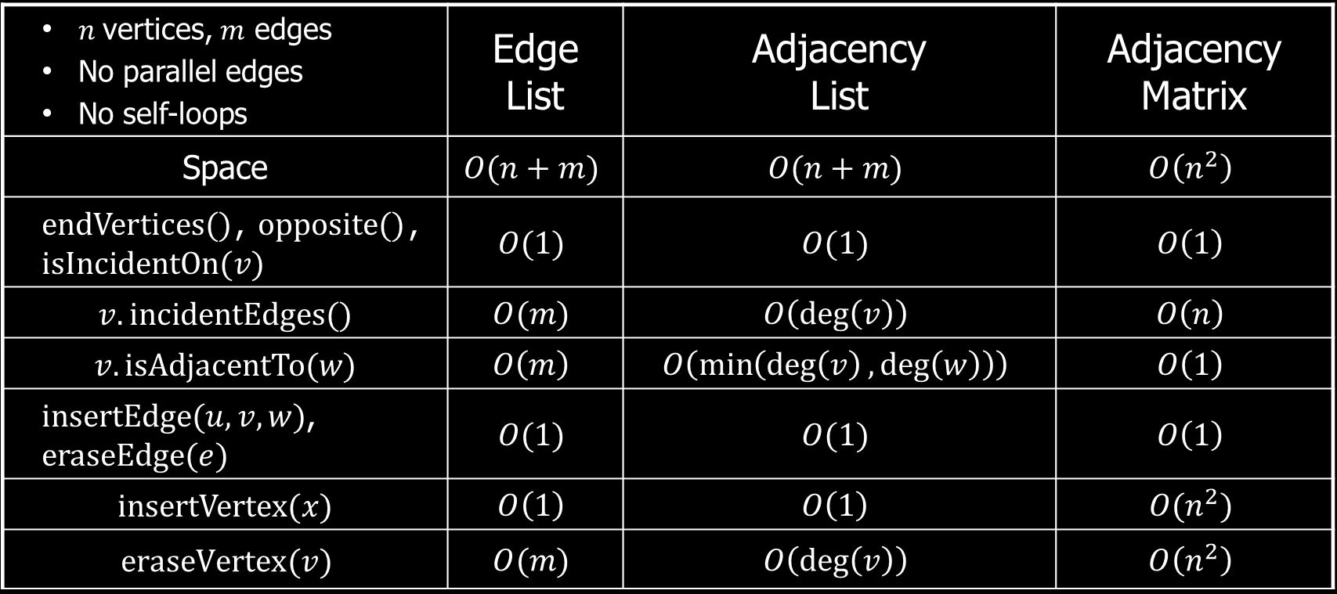
Asymptotic Performance
$n$vertices, $m$ edges No parallel edges No self-loops | Edge List | Adjacency List | Adjacency Matrix
Space | $$O(n+m)$$ | $$O(n+m)$$ | $$O\left(n^{2}\right)$$
$endVertices()$, $opposite()$, $isIncidentOn(v)$ | $$O(1)$$ | $$O(1)$$ | $$O\left(1\right)$$
$$v.incidentEdges()$$ | $$O(m)$$ | $$O\left(\deg\left(v\right)\right)$$ | $$O\left(n\right)$$
$$v.isAdjacentTo(w)$$ | $$O\left(m\right)$$ | $$O\left(\min\left(\deg\left(v\right),\deg\left(w\right)\right)\right)$$ | $$O\left(1\right)$$
$insertEdge(u, v, w)$, $eraseEdge(e)$ | $$O(1)$$ | $$O(1)$$ | $$O\left(1\right)$$
$$insertVertex(x)$$ | $$O\left(1\right)$$ | $$O\left(1\right)$$ | $$O(n^{2})$$
$$eraseVertex(v)$$ | $$O(m)$$ | $$O\left(\deg\left(v\right)\right)$$ | $$O\left(n^{2}\right)$$
Notes:
Weight of an edge

Slide 39
Depth-First Search
A
B
D
E
C

Slide 40


Depth-First Search
Depth-first search (DFS) is a general technique for traversing a graph
A DFS traversal of a graph $G$
  Visits all the vertices and edges of $G$
  Determines whether $G$ is connected
  Computes the connected components of $G$
  Computes a spanning forest of $G$
DFS on a graph with n vertices and m edges takes $O(n+m)$ time
DFS can be further extended to solve other graph problems
  Find and report a path between two given vertices
  Find a cycle in the graph
Depth-first search is to graphs what Euler tour is to binary trees

Slide 41

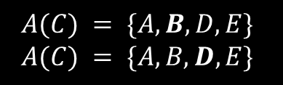

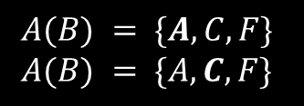
Example
$$A(B) = \{A, C, F\} \\ A(B) = \{A, C, F\}$$
A
unexplored vertex
A
A
visited vertex
B
D
E
unexplored edge
discovery edge
G
F
C
back edge
$$A(A) = \{B, C, D, E\}$$
$$A(C) = \{A, B, D, E\}$$
A
A
B
D
E
B
D
E
F
C
G
F
C
G
$$A(C) = \{A, B, D, E\} \\ A(C) = \{A, B, D, E\}$$
Notes:
Explore incident edges in order, go along the unexplored edge
1. Seeing a neighbor already explored -> check next edge
2. Reaching dead end (no more edges to explore) -> go back to parent

Slide 42

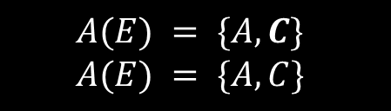




Example
$$A(C) = \{A, B, D, E\}$$
$$A(C) = \{A, B, D, E\}$$
A
A
B
D
E
B
D
E
F
C
G
F
C
G
$$A(D) = \{A, C\}$$
$$A(E) = \{A, C\}$$
A
A
B
D
E
B
D
E
F
C
G
F
C
G
$$A(D) = \{A, C\} \\ A(D) = \{A, C\}$$
$$A(E) = \{A, C\} \\ A(E) = \{A, C\}$$

Slide 43

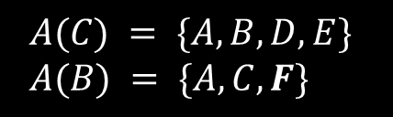
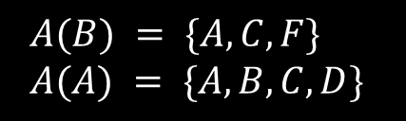

Example
$$A(C) = \{A, B, D, E\} \\ A(B) = \{A, C, F\}$$
A
A
$$A(G) =∅$$
B
D
E
B
D
E
F
C
G
F
C
G
$$A(F) = \{B\}$$
A
B
D
E
F
C
G
$$A(B) = \{A, C, F\} \\ A(A) = \{A, B, C, D\}$$

Slide 44
DFS and Maze Traversal
The DFS algorithm is similar to a classic strategy for exploring a maze
  We mark each intersection, corner and dead end (vertex) visited
  We mark each corridor (edge) traversed
  We keep track of the path back to the entrance (start vertex) by means of a rope (recursion stack)
Notes:
Use a rope to mark the visited route. Choose an unexplored way at the intersection
1. Seeing the rope -> choose another way
2. Reaching dead end (no more ways to explore) -> go back to the last intersection

Slide 45


DFS Algorithm
The algorithm uses a mechanism for setting and getting “labels” of vertices and edges
Algorithm $DFS(G)$
Input: Graph $G$
Output: Labeling of the edges of $G$ as discovery edges
and back edges
for each $v∈G.vertices\left( \right)$ do
$v.setLabel\left(UNEXPLORED\right)$
for each $e∈G.edges\left( \right)$ do
$e.setLabel(UNEXPLORED)$
for each $v∈G.vertices\left( \right)$ do
if $v.getLabel\left( \right)=UNEXPLORED$
$DFS(G, v)$
Algorithm $DFS(G, v)$
Input: Graph $G$ and a start vectex $v$
Output: Labeling of the edges of $G$ in the
connected component of $v$ as discovery edges
and back edges
$v.setLabel(VISITED)$
for each $e∈v.incidentEdges\left( \right)$ do
if $e.getLabel\left( \right)=UNEXPLORED)$
$w←e.opposite(v)$
if $w.getLabel\left( \right)=UNEXPLORED$
$e.setLabel(DISCOVERY)$
$DFS(G, w)$
else
$e.setLabel(BACK)$

Slide 46
Exercise
DFS Algorithm
Perform DFS of the following graph, start from vertex A
  Assume adjacent edges are processed in alphabetical order
  Number vertices in the order they are visited
  Label edges as discovery or back edges
A
B
C
D
E
F

Slide 47

Properties of DFS
Property 1
  $DFS(G, v)$visits all the vertices and edges in the connected component of $v$
Property 2
  The discovery edges labeled by $DFS(G, v)$form a spanning tree of the connected component of $v$
v₁
A
B
D
E
F
C
G
v₂

Slide 48

Analysis of DFS
Setting/getting a vertex/edge label takes $O(1)$time
Each vertex is labeled twice
  once as $UNEXPLORED$
  once as $VISITED$
Each edge is labeled twice
  once as $UNEXPLORED$
  once as $DISCOVERY$ or $BACK$
Function $DFS(G, v)$and the method $incidentEdges\left( \right)$ are called once for each vertex
A
B
D
E
F
C
G

Slide 49


Analysis of DFS
DFS runs in $O(n+m)$ time provided the graph is represented by the adjacency list structure
  Recall that $Σ_{v}\deg\left(v\right)=2m$
Algorithm $DFS(G)$
Input: Graph $G$
Output: Labeling of the edges of $G$ as discovery edges
and back edges
for each $v∈G.vertices\left( \right)$ do $O(n)$
$v.setLabel\left(UNEXPLORED\right)$
for each $e∈G.edges\left( \right)$ do $O(m)$
$e.setLabel(UNEXPLORED)$
for each $v∈G.vertices\left( \right)$ do $O(n+m)$
if $v.getLabel\left( \right)=UNEXPLORED$
$DFS(G, v)$
Algorithm $DFS(G, v)$
Input: Graph $G$ and a start vectex $v$
Output: Labeling of the edges of $G$ in the
connected component of $v$ as discovery edges
and back edges
$v.setLabel(VISITED)$
for each $e∈v.incidentEdges\left( \right)$ do $O\left(deg\left(v\right)\right)$
if $e.getLabel\left( \right)=UNEXPLORED)$
$w←e.opposite(v)$
if $w.getLabel\left( \right)=UNEXPLORED$
$e.setLabel(DISCOVERY)$
$DFS(G, w)$
else
$e.setLabel(BACK)$

Slide 50


Application
Path Finding
We can specialize the DFS algorithm to find a path between two given vertices $u$ and $z$ using the template method pattern
We call $DFS(G, u)$with $u$ as the start vertex
We use a stack $S$ to keep track of the path between the start vertex and the current vertex
As soon as destination vertex $z$ is encountered, we return the path as the contents of the stack
Algorithm $pathDFS(G, v, z)$
$v.setLabel(VISITED)$
$S.push(v)$
if $v=z$
return $S.elements( )$
for each $e∈v.incidentEdges\left( \right)$ do
if $e.getLabel\left( \right)=UNEXPLORED)$
$w←e.opposite(v)$
if $w.getLabel\left( \right)=UNEXPLORED$
$e.setLabel(DISCOVERY)$
$S.push(e)$
$pathDFS\left(G, w\right)$
$S.pop( )$
else
$e.setLabel(BACK)$
$S.pop( )$

Slide 51


Application
Cycle Finding
Algorithm $cycleDFS(G, v, z)$
$v.setLabel(VISITED)$
$S.push(v)$
for each $e∈v.incidentEdges\left( \right)$ do
if $e.getLabel\left( \right)=UNEXPLORED)$
$w←e.opposite(v)$
$S.push\left(e\right)$
if $w.getLabel\left( \right)=UNEXPLORED$
$e.setLabel(DISCOVERY)$
$cycleDFS\left(G, w\right)$
$S.pop( )$
else
$T←$ empty stack
repeat
$T.push\left(S.top\left( \right)\right)$
$S.pop\left( \right)$
until $T.top\left( \right)=w$
return $T.elements\left( \right)$
$S.pop( )$
We can specialize the DFS algorithm to find a simple cycle using the template method pattern
We use a stack $S$ to keep track of the path between the start vertex and the current vertex
As soon as a back edge $\left(v,w\right)$ is encountered, we return the cycle as the portion of the stack from the top to vertex $w$

Slide 52
Breadth-First Search
L₀
A
L₁
B
C
D
L₂
E
F

Slide 53


Breadth-First Search
Breadth-first search (BFS) is a general technique for traversing a graph
A BFS traversal of a graph $G$
  Visits all the vertices and edges of $G$
  Determines whether $G$ is connected
  Computes the connected components of $G$
  Computes a spanning forest of $G$
BFS on a graph with n vertices and m edges takes $O(n+m)$ time
BFS can be further extended to solve other graph problems
  Find and report a path with the minimum number of edges between two given vertices
  Find a simple cycle, if there is one

Slide 54
Example
L₀
unexplored vertex
A
A
A
visited vertex
L₁
B
C
D
unexplored edge
discovery edge
E
F
cross edge
L₀
L₀
A
A
L₁
L₁
B
C
D
B
C
D
E
F
E
F

Slide 55
Example
A
unexplored vertex
A
visited vertex
unexplored edge
discovery edge
cross edge
L₀
L₀
A
A
L₁
L₁
B
C
D
B
C
D
L₂
E
F
E
F
L₀
L₀
A
A
L₁
L₁
B
C
D
B
C
D
L₂
L₂
E
F
E
F

Slide 56
Example
A
unexplored vertex
A
visited vertex
unexplored edge
discovery edge
cross edge
L₀
L₀
A
A
L₁
L₁
B
C
D
B
C
D
L₂
L₂
E
F
E
F
L₀
A
L₁
B
C
D
L₂
E
F

Slide 57


BFS Algorithm
Algorithm $BFS(G, s)$
$L_{0}←\left\{s\right\}$
$s.setLabel(VISITED)$
$i←0$
while $¬L_{i}.empty( )$ do
$L_{i+1}←∅$
for each $v∈L_{i}$ do
for each $e∈v.incidentEdges( )$ do
if $e.getLabel\left( \right)=UNEXPLORED$
$w←e.opposite\left(v\right)$
if $w.getLabel\left( \right)=UNEXPLORED$
$e.setLabel(DISCOVERY)$
$w.setLabel(VISITED)$
$L_{i+1}←L_{i+1}∪\left\{w\right\}$
else
$e.setLabel(CROSS)$
$i←i+1$
The algorithm uses a mechanism for setting and getting “labels” of vertices and edges
Algorithm $BFS(G)$
Input: Graph $G$
Output: Labeling of the edges and partition of the vertices of $G$
for each $v∈G.vertices\left( \right)$ do
$v.setLabel(UNEXPLORED)$
for each $e∈G.edges( )$ do
$e.setLabel(UNEXPLORED)$
for each $v∈G.vertices( )$ do
if $v.getLabel\left( \right)=UNEXPLORED$
$BFS\left(G, v\right)$

Slide 58
Exercise
BFS Algorithm
Perform BFS of the following graph, start from vertex A
  Assume adjacent edges are processed in alphabetical order
  Number vertices in the order they are visited and note the level they are in
  Label edges as discovery or cross edges
A
B
C
D
E
F

Slide 59

Properties
A
Notation
  $G_{s}$: connected component of $s$
Property 1
  $BFS(G, s)$visits all the vertices and edges of $G_{s}$
Property 2
  The discovery edges labeled by $BFS\left(G, s\right)$ form a spanning tree $T_{s}$ of $G_{s}$
Property 3
  For each vertex $v∈L_{i}$
    The path of $T_{s}$ from $s$ to $v$ has $i$ edges
    Every path from $s$ to $v$ in $G_{s}$ has at least $i$ edges
B
C
D
E
F
L₀
A
L₁
B
C
D
L₂
E
F

Slide 60

Analysis
Setting/getting a vertex/edge label takes O(1) time
Each vertex is labeled twice
  once as UNEXPLORED
  once as VISITED
Each edge is labeled twice
  once as UNEXPLORED
  once as DISCOVERY or CROSS
Each vertex is inserted once into a sequence $L_{i}$
Method $incidentEdges( )$ is called once for each vertex
BFS runs in $O\left(n+m\right)$ time provided the graph is represented by the adjacency list structure
  Recall that $Σ_{v}\deg\left(v\right)=2m$

Slide 61


Analysis of BFS
Algorithm $BFS(G, s)$
$L_{0}←\left\{s\right\}$
$s.setLabel(VISITED)$
$i←0$
while $¬L_{i}.empty( )$ do
$L_{i+1}←∅$
for each $v∈L_{i}$ do $O\left(deg\left(v\right)\right)$
for each $e∈v.incidentEdges( )$ do
if $e.getLabel\left( \right)=UNEXPLORED$
$w←e.opposite\left(v\right)$
if $w.getLabel\left( \right)=UNEXPLORED$
$e.setLabel(DISCOVERY)$
$w.setLabel(VISITED)$
$L_{i+1}←L_{i+1}∪\left\{w\right\}$
else
$e.setLabel(CROSS)$
$i←i+1$
The algorithm uses a mechanism for setting and getting “labels” of vertices and edges
Algorithm $BFS(G)$
Input: Graph $G$
Output: Labeling of the edges and partition of the vertices of $G$
for each $v∈G.vertices\left( \right)$ do $O(n)$
$v.setLabel(UNEXPLORED)$
for each $e∈G.edges( )$ do $O\left(m\right)$
$e.setLabel(UNEXPLORED)$
for each $v∈G.vertices( )$ do $O\left(n+m\right)$
if $v.getLabel\left( \right)=UNEXPLORED$
$BFS\left(G, v\right)$

Slide 62

Applications
Using the template method pattern, we can specialize the BFS traversal of a graph $G$ to solve the following problems in $O\left(n+m\right)$ time
  Compute the connected components of $G$
  Compute a spanning forest of $G$
  Find a simple cycle in $G$, or report that $G$ is a forest
  Given two vertices of $G$, find a path in $G$ between them with the minimum number of edges, or report that no such path exists

Slide 63
DFS vs. BFS
Applications | DFS | BFS
Spanning forest, connected components, paths, cycles | √ | √
Shortest paths |  | √
Biconnected components | √
L₀
A
A
L₁
B
C
D
B
C
D
L₂
E
F
E
F
DFS
BFS

Slide 64


DFS vs. BFS
Back edge $\left(v, w\right)$
  $w$ is an ancestor of $v$ in the tree of discovery edges
Cross edge $\left(v, w\right)$
  $w$ is in the same level as $v$ or in the next level in the tree of discovery edges
L₀
A
A
L₁
B
C
D
B
C
D
L₂
E
F
E
F
DFS
BFS

